Slide 1
WEB & HYBRID DECISION SUPPORT SYSTEM FOR ENERGY ASSESSMENT IN AGRICULTURE (AGROENERGY APP)
Team Members: Saqib Parvaze
Sumit Chaudhary
Megha Basera
Faizan Latif

Slide 2
PROBLEMS
Poor Mechanisation Accessibility
Poor Mechanisation Services
Poor Land Consolidation

Slide 3
CHALLENGES
Lack of awareness/knowledge
Lack of resource availability and accessibility
Small and scattered land holdings
Tractor-isation and not mechanization
Poor recycling of agricultural wastes

Slide 4
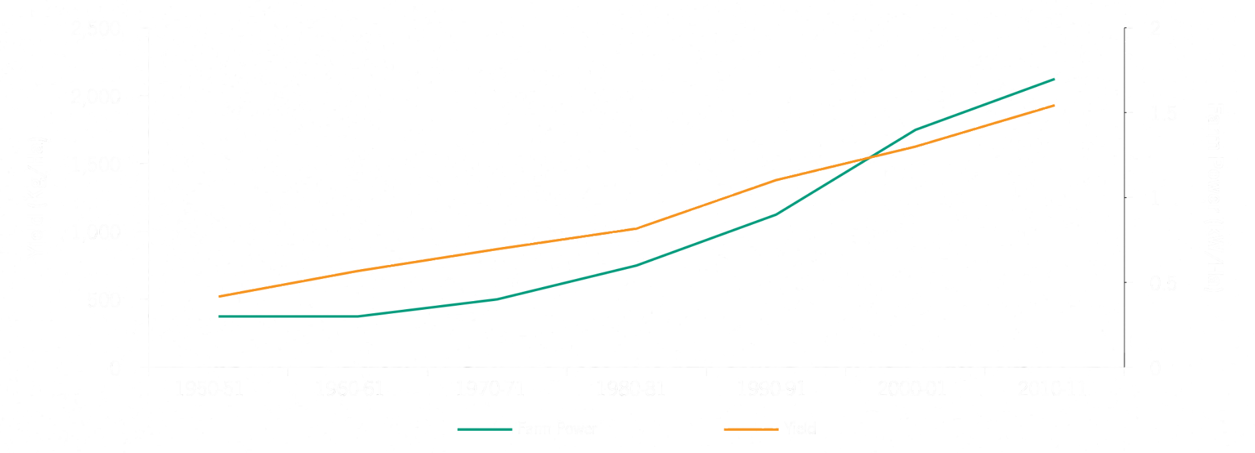
MECHANISATION BENEFITS
Input
savings
Increase in efficiency
Social
benefits
Relationship between farm power and productivity
Source: Ministry of Agriculture

Slide 5














CALCULATE ENERGY INPUTS...
APP
CAN...
OPERATION WISE
SOURCE WISE

Slide 6



THEREBY HELPS IN DECISION MAKING
COMPARE CHOICES

Slide 7





Buy:
CHOICES AVAILABLE
OR
Specifications
Price
Compare
Custom
Hire (per acre):
A
B
C
A
B
C

Slide 8
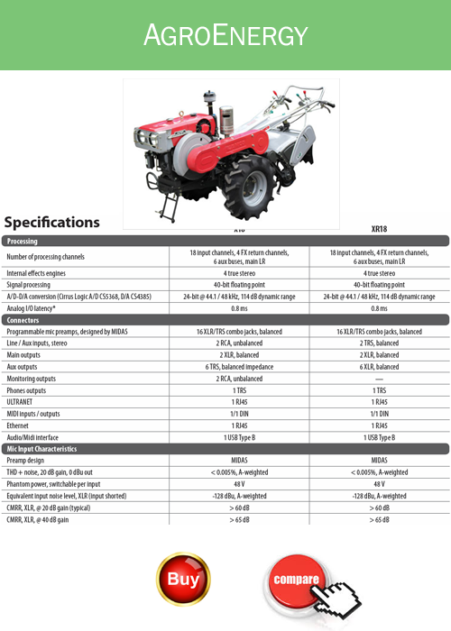
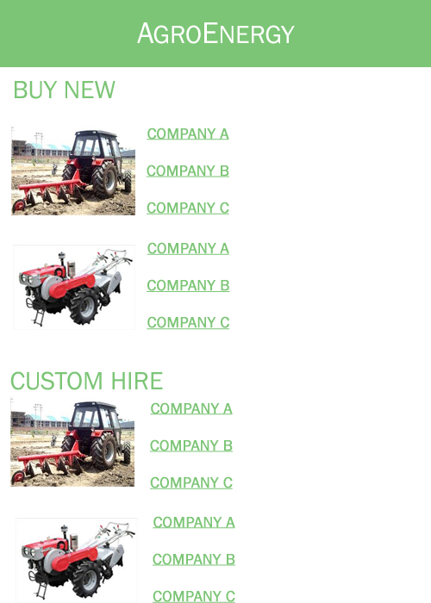
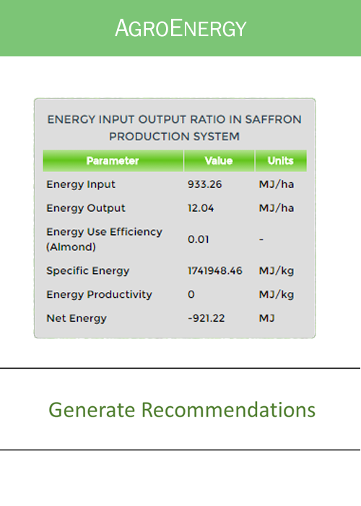
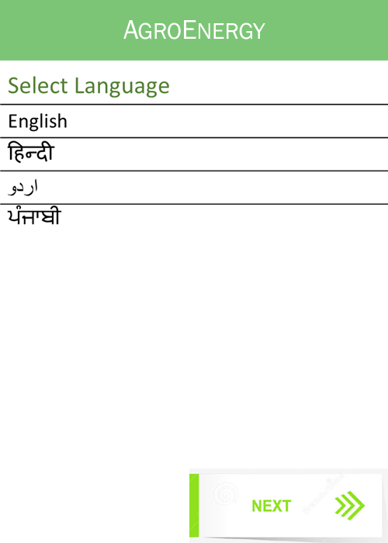
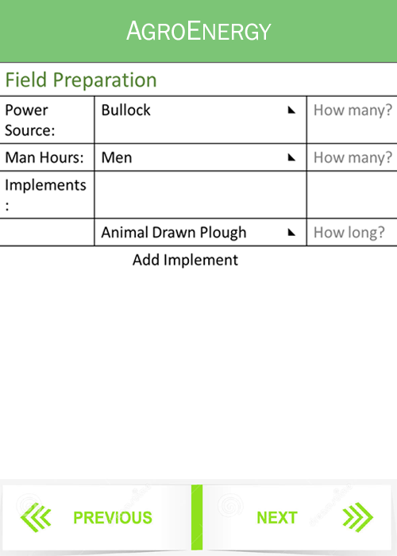
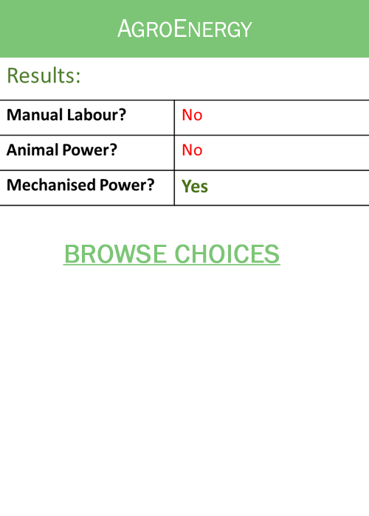
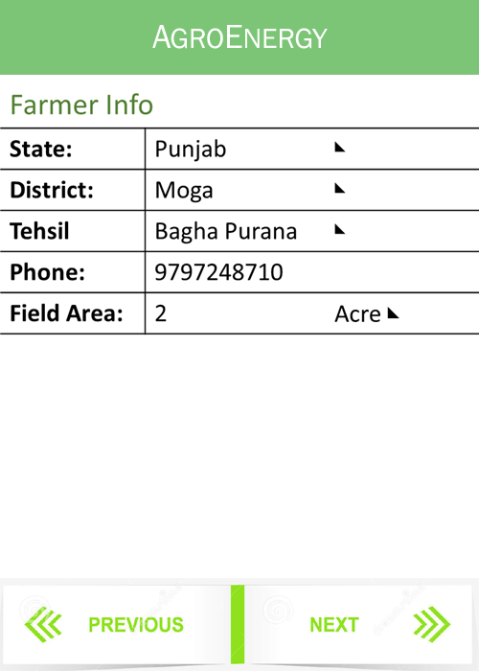
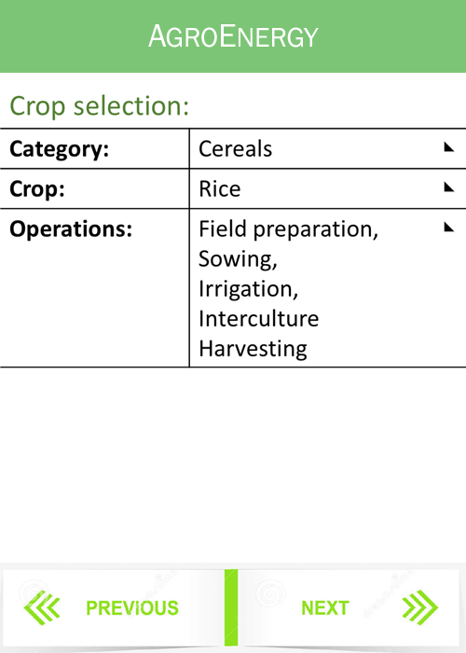
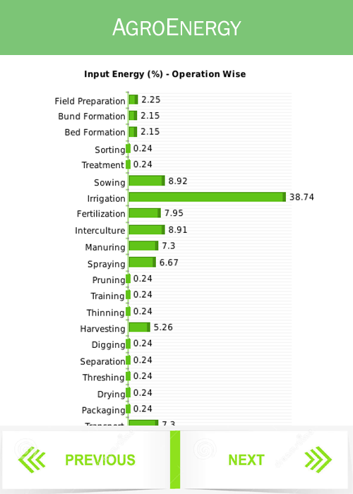
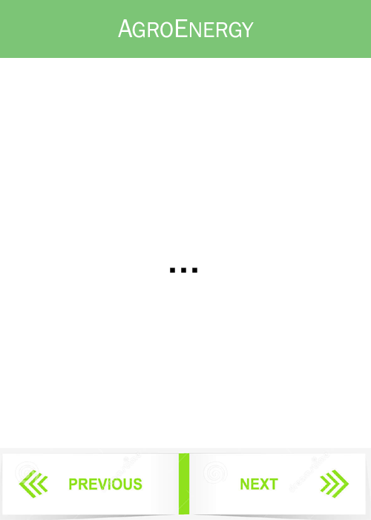
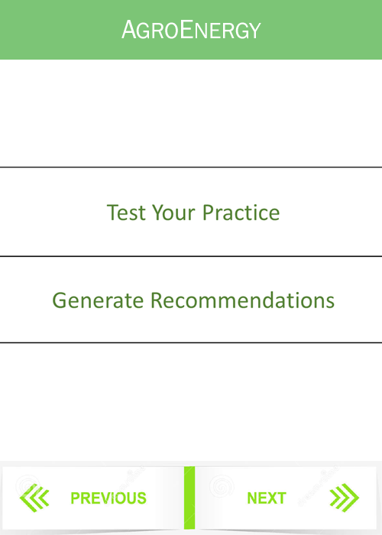
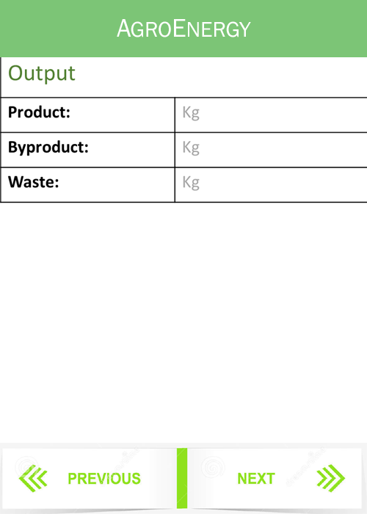

Slide 9











MULTIPLE PLATFORMS
SUPPORTS….
ANYWHERE ACCESS WITH INTERNET

Slide 10
BUSINESS MODEL
Investment
Revenue
Dealer Registration
Revenue per Lead
Owners
Capital
(App Development)
Travel
Manpower
Call Centre
Commission on Purchase
Data sales
Office Establishment
Advertisements
Additional sponsors
Information Hub
FLD’s
Other Expenses

Slide 11
Thankyou

